Slide 1
Finding Optimal Location for a New Mexican Restaurant in New York City
Xin Zhang
12-4-2020

Slide 2
Introduction
This project is to find an optimal location to open a Mexican restaurant in New York City.
Several factors should be considered in this project:
the number of the same type restaurants nearby;
the population density near the new restaurant.

Slide 3
Introduction
New York City is composed of five boroughs: The Bronx, Brooklyn, Manhattan, Queens, and Staten Island.
Manhattan is the most densely populated of them. So, this project will focus on Manhattan and find optimal restaurant location in this area.
Manhattan contains more than 40 neighborhoods, the population is 1.628 million. There are over 25,000 restaurants and bars, of which over 500 are Mexican restaurants.

Slide 4
Data Acquisition & Cleaning
New York City population density by borough here.
Manhattan neighborhoods here.
Mexican restaurants data can be downloaded through Foursquare API.
Manhattan population by neighborhood data here.
New York City geojson file used to generate map can be downloaded here.
The cleaned dataframe contains 5 columns and 43 rows.

Slide 5
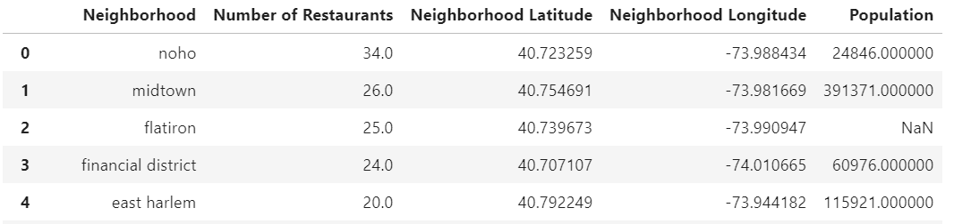
Methodology
After merging all the datasets together, I get the following dataframe.

Slide 6
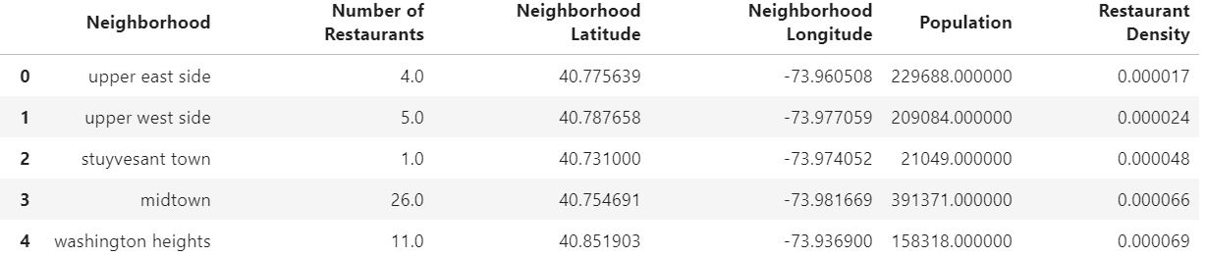
Methodology
To better analyze the potential capacity for consumption in each neighborhood, I added a column name “Restaurant Density”, which is calculate by “Number of Restaurants”/“Population”.
*Lower “Restaurant Density” neighborhood means it has more potential to open a new restaurant.

Slide 7
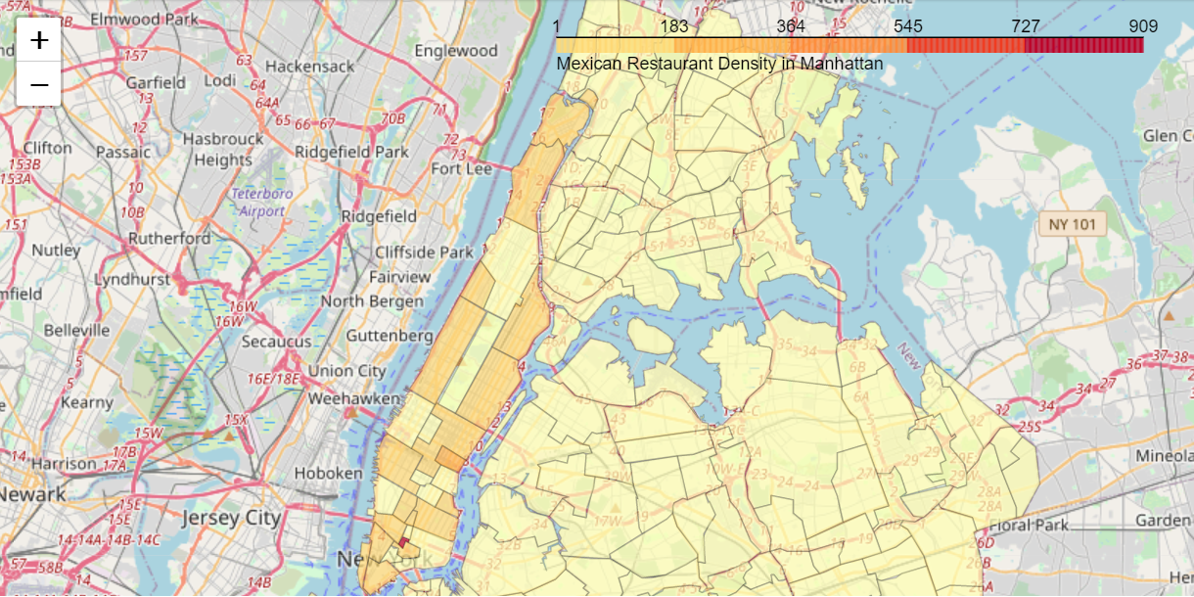
Methodology
Use python folium Choropleth map to show the restaurant density of each neighborhood.
Yellow: Higher potential
Red: Lower potential

Slide 8
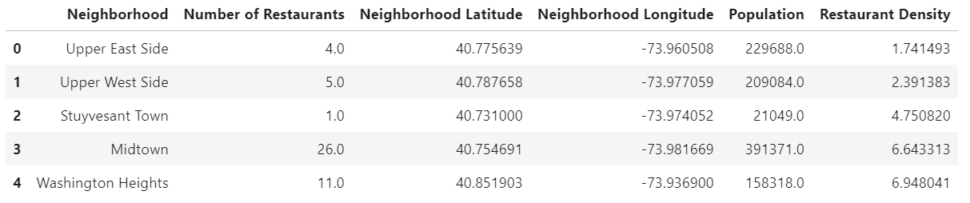
Result
The goal of this project is to provide 5 best locations to the restaurant owner and stakeholders to make the final decision. The result is shown below.

Slide 9
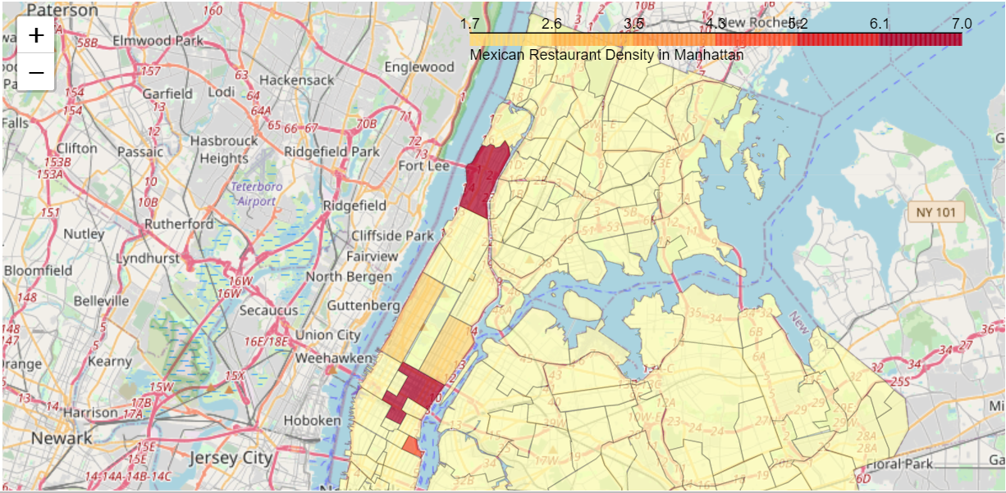
Result
Four of the five neighborhoods are large, which have more Mexican restaurants and higher population. Only Stuyvesant Town is a small area and also has less population.

Slide 10
Conclusion & Future Directions
Built a method to evaluate the potential capacity for consumption in each neighborhood.
Created Choropleth map to visualize the restaurant density of each neighborhood.
Provided 5 optimal locations as candidates for restaurant owner and stakeholders to make the final decision.
Future directions: gather comprehensive data and include more conditions in the project.

Slide 11
Thank you!

